Slide 1
Intro to Coding with Python– Designing
Dr. Ab Mosca (they/them)
Slides based off slides courtesy of Jordan Crouser (https://jcrouser.github.io/)

Slide 2
Plan for Today
User-centered design
What it is
Why do it
Ways to do it

Slide 3
Hypothetical example
“Advising Assistant”

Slide 4
Hypothetical example
Overview: over 100 majors and minors in CS, CIS, and DS
Image © JOHN TRABBIC III, Storyboard Artist / Cartoonist
Notes:
This year, CSC major hit a 30-year record:
18&18J: 33M + 3m, graduating this May. 19&19J: 41M + 1m 20&20J: 39M + 3m 21&21J: 1M

Slide 5

Hypothetical example
Overview: three advising faculty

Slide 6

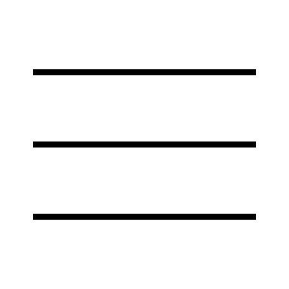

Hypothetical example
Overview: Degreeworks not hugely helpful…
Notes:
When I log into degreeworks, I can find an individual advisee, and the specific classes they’ve taken, but there’s no clear progress towards the major or graduation unless I scroll and write everything down myself
I also can’t see which remaining requirements they could get next semester and which are offered infrequently

Slide 7
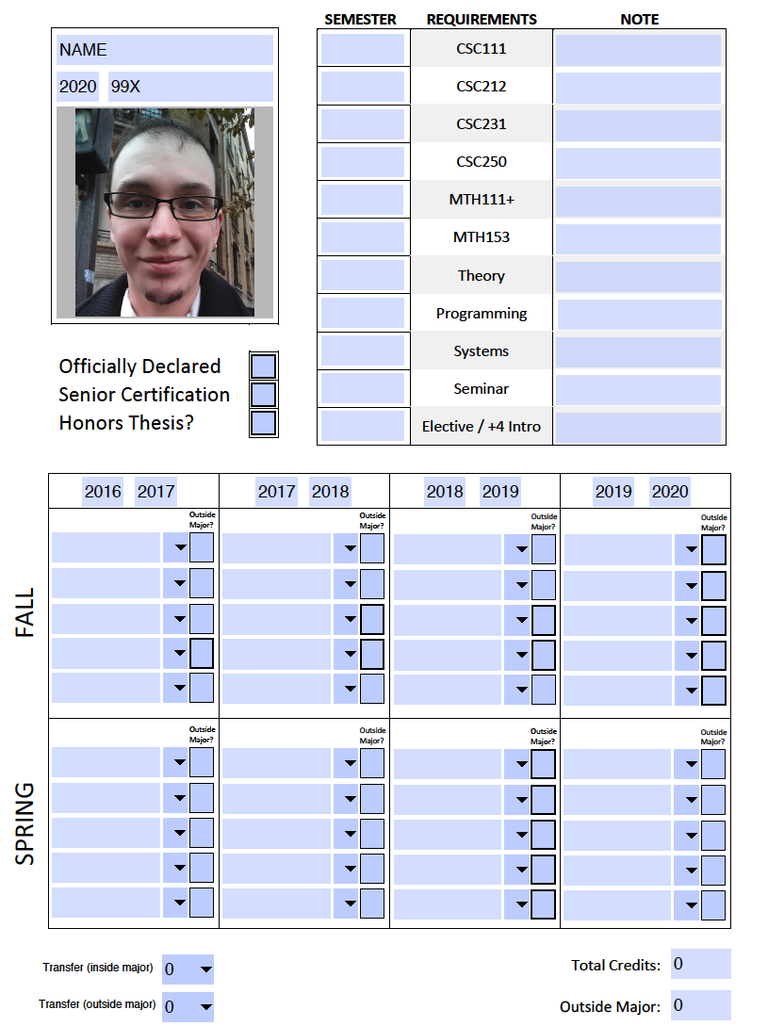

Hypothetical example
Overview:
current process
is manual
Goal 1:
detect which courses a student needs for the major and when they will next be offered
Goal 2:
give adviser an overview of all advisees
Notes:
This worked really well when I had 10 or so advisees, but now I have 43!

Slide 8
Hypothetical example
Ideal: we would like to build a plugin that sits on top of Degreeworks and does everything for us, but that won’t work because of FERPA concerns
Actual strategy:
Define mapping from course numbers to major/minor designation
Use historical data to determine the rotation on which classes are offered
Export CSV of all advisees from Degreeworks
Build a parser that extracts data from unofficial transcript (i.e. courses taken) and joins with mapping, majors/minors
Build authenticated frontend for adviser to track student progress

Slide 9
Hypothetical example
Ideal: we would like to build a plugin that sits on top of Degreeworks and does everything for us, but that won’t work because of FERPA concerns
Actual strategy:
Define mapping from course numbers to major/minor designation
Use historical data to determine the rotation on which classes are offered
Export CSV of all advisees from Degreeworks
Build a parser that extracts data from unofficial transcript (i.e. courses taken) and joins with mapping, majors/minors
Build authenticated frontend for adviser to track student progress
Notes:
This is the only part the user of your application will see!

Slide 10
Discussion
Let’s say you wanted to actually implement this;
where do you start?

Slide 11
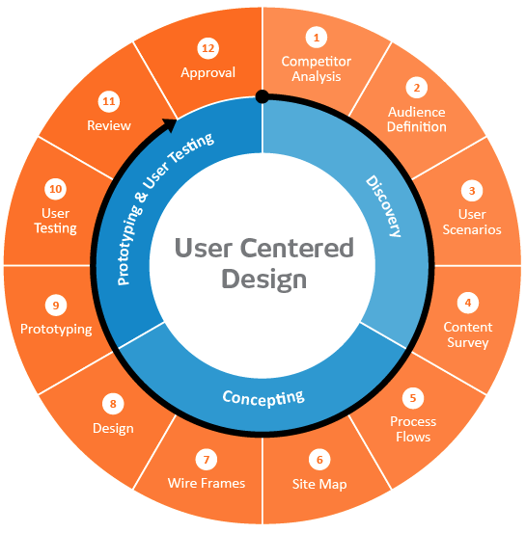

User-centered design framework
1) Discovery
Learning about your users
Modeling your users
Analyzing your users’ tasks
Eliciting and defining clear product requirements
2) Concepting Phase
Developing conceptual models
Solving design problems through ideation
Detailed design activities
3) Prototyping + User Testing
Delivery of a high-quality product that meets users’ needs and is easy to learn and use
Users
http://www.uxmatters.com/mt/archives/2010/07/design-is-a-process-not-a-methodology.php
Notes:
All Phases
Each phase feeds into the next
Iteration is key!
Users involved at all phases of the process

Slide 12
Defining your audience
Learning about their problem
Semi-structured interview
Analyzing their tasks
Hierarchical task analysis
Modeling users
Personas

Slide 13
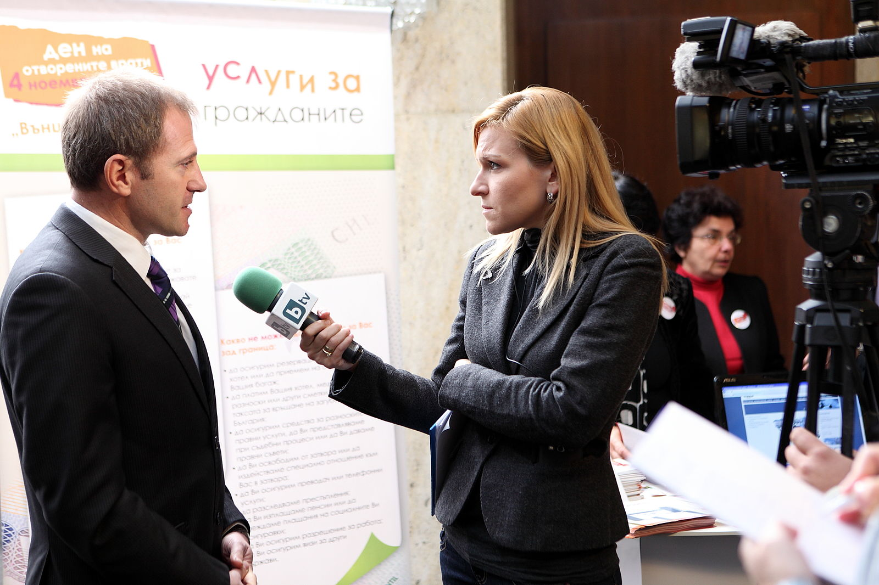
Semi-structured interviews
Why?
gather qualitative data about users to understand the problem
can help identify key differences between designer and target user
How?
ask open-ended questions
bring along a “cheat sheet” to
ensure that you gather all the
information you need
Some tips:
establish trust at the beginning
participant engagement will vary
be flexible, but make sure you get what you came for
consider recording or note-taking to help with recall
Wood, L. E. (1997). Semi-structured interviewing for user-centered design. interactions, 4(2), 48-61.

Slide 14
Defining your audience
Learning about their problem
Semi-structured interview
Analyzing their tasks
Hierarchical task analysis
Modeling users
Personas

Slide 15
Hierarchical task analysis
Why?
Understand user workflow
Identify pain points and areas for optimization
How?
Decompose tasks into 4-8 sequential steps
Identify patterns, sequences and skips in the tasks
An example:
Hackos, J. & Redish, J. (1998). User and Task Analysis for Interface Design. Chichester: Wiley.

Slide 16
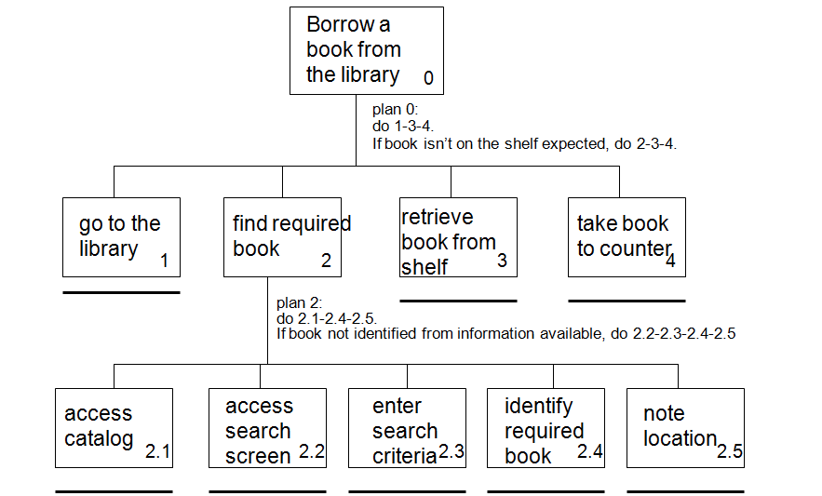
Task analysis example
http://i1206241.blogspot.com/2013/01/task-descriptions-hierarchical-task.html

Slide 17
Defining your audience
Learning about your users
Semi-structured interview
Contextual inquiry
Analyzing users’ tasks
Hierarchical task analysis
Modeling users
Personas

Slide 18
Personas
Why?
mechanism for reasoning about user needs
model behavioral characteristics of target users
doesn’t require access to ACTUAL users
How?
fictionalization
narrative, goals, needs, “pain points”
attributes specific to the problem space
data-driven method* using info from interviews
mapping persona to software features

Slide 19
Personas
Example: Persona for a user of the advising app
Dr. Betty is a visiting lecturer for WSU. She has never worked for this university before but has worked at others. She was assigned 35 advisees, and half of them are juniors and seniors.
Dr. Betty is familiar with technology and has no problem using software to help with advising (in fact, she likes it). However, because she has never been at Westfield before, she does not know which classes are offered yearly, every other year, every third year, etc.. Because she is advising juniors and seniors, it is crucial that she has access to this information.
In addition, Dr. Betty has limited time. She needs to be able to quickly see which of her advisees are on track and which require some extra attention when it comes to selecting classes.

Slide 20

Activity: personas
Goal: come up with 3 personas that characterize users of a a public transit app be specific

Slide 21
Now that we’ve got some end users in mind,
what would a prototype look like?

